Slide 1
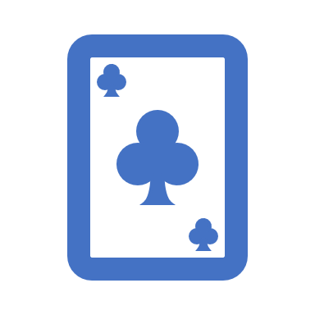
AI for One-card -Korean card game-
201421168 하성곤

Slide 2
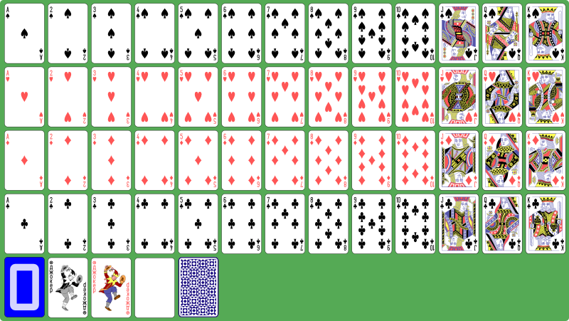
54 playing cards

Slide 3
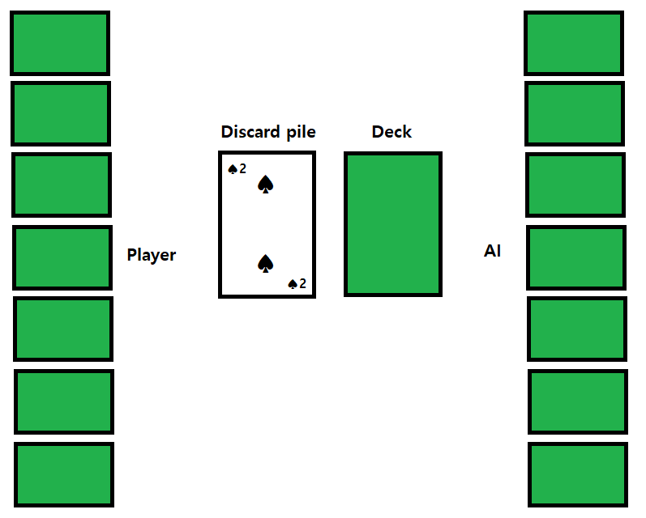
Playing One-card

Slide 4

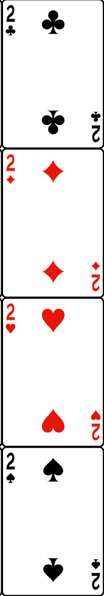
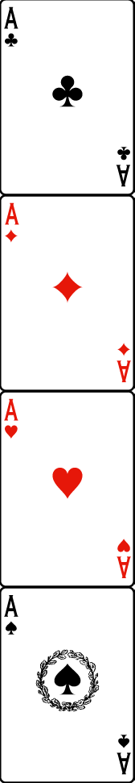
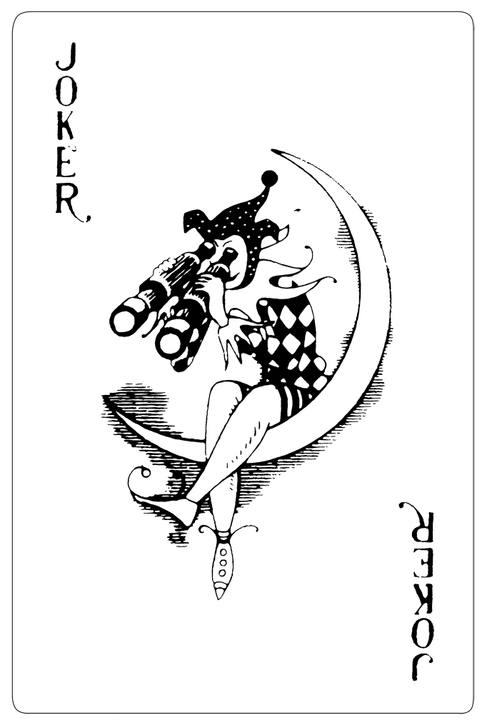
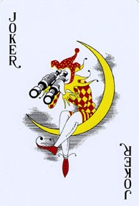
Attack card ‘2’
2 damage
other can play 2, A(same shape), Joker

Slide 5
Attack card ‘A’
3 damage
♠ A : 5 damage
other can play A, Joker

Slide 6
Attack card ‘Joker’
10 damage
other can play Nothing
7 damage
other can play colored joker

Slide 7
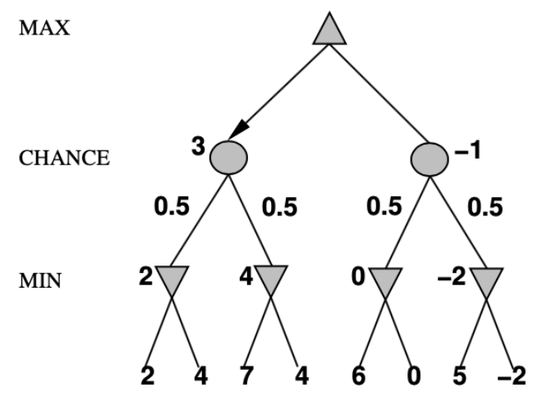
Expectiminimax
Minimax with chance node

Slide 8
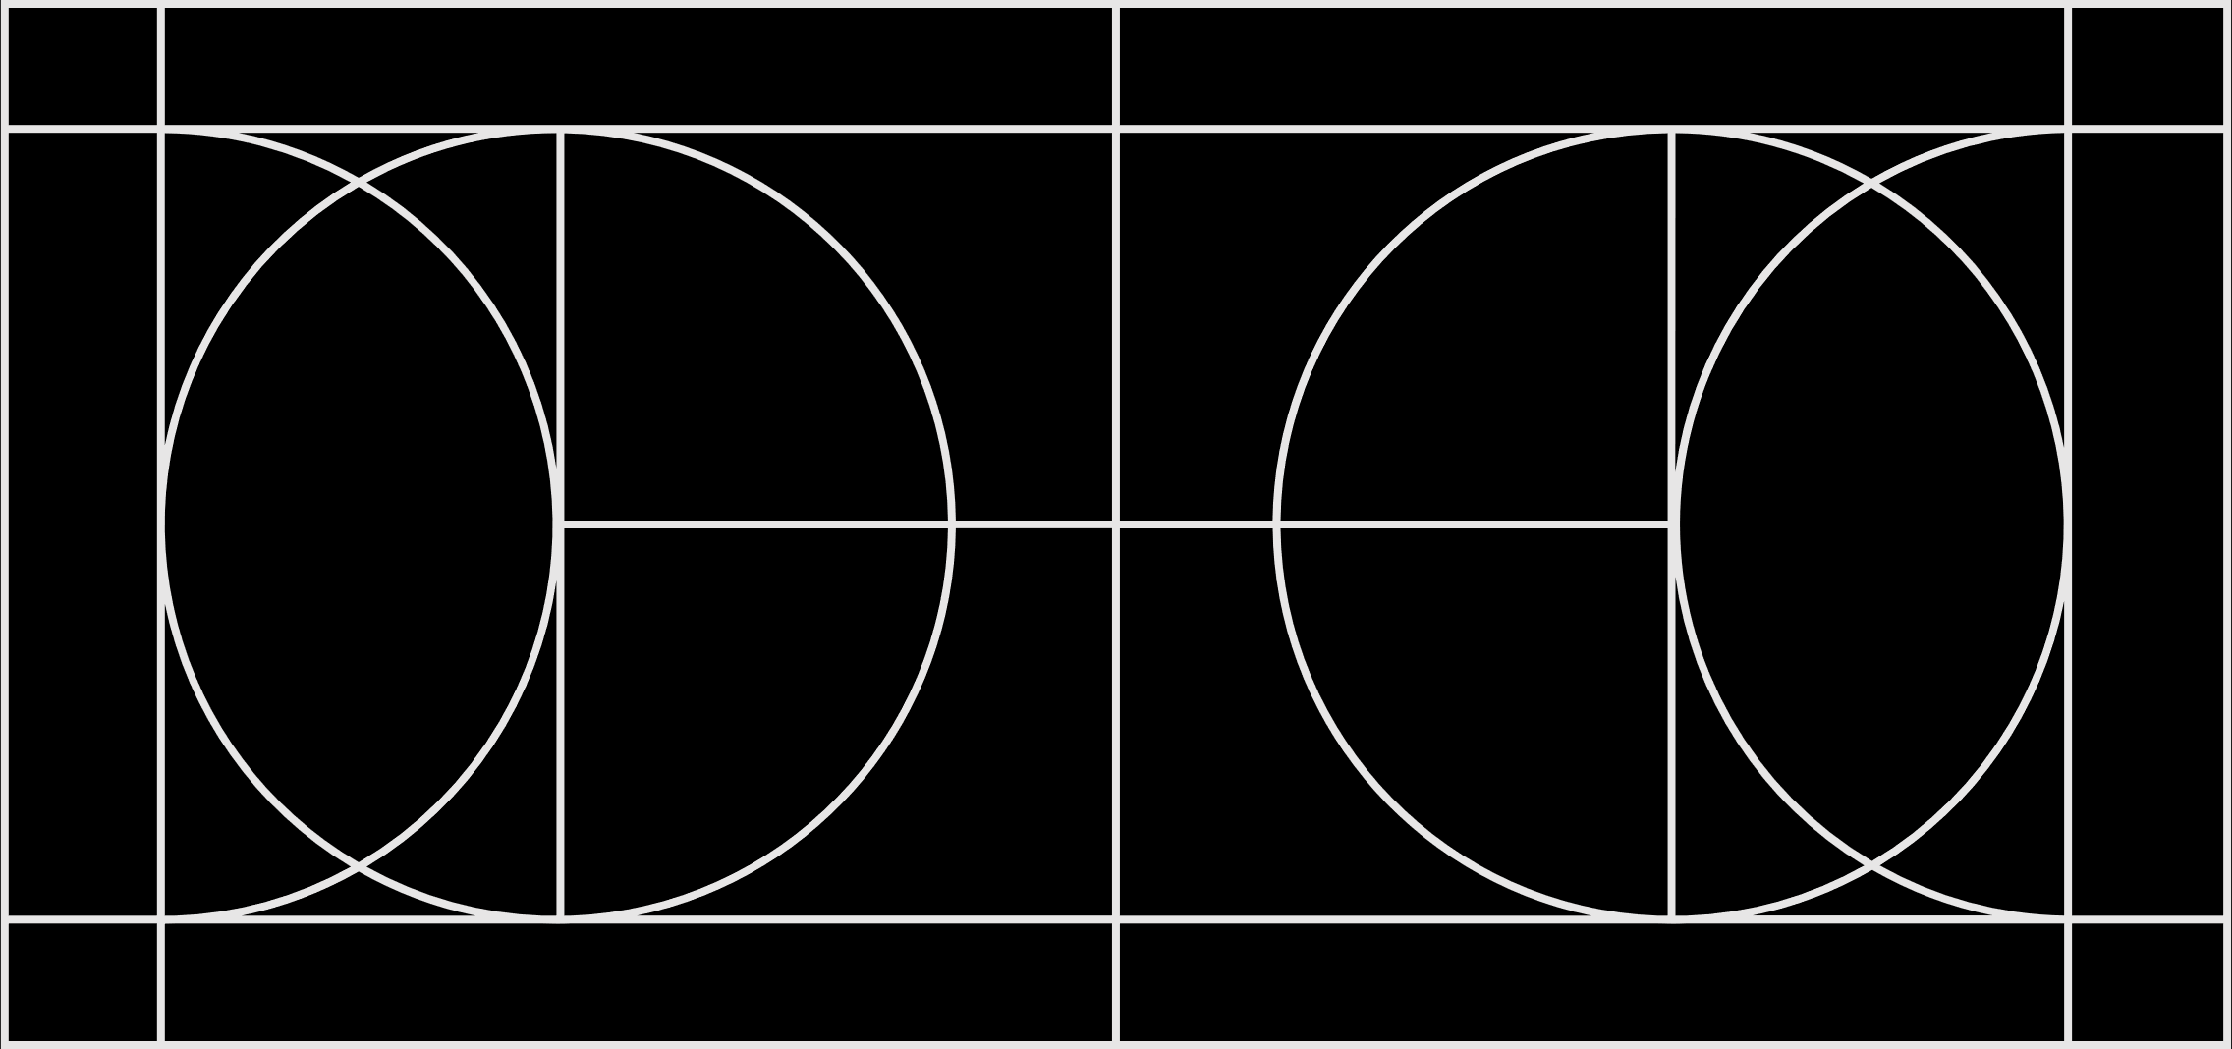
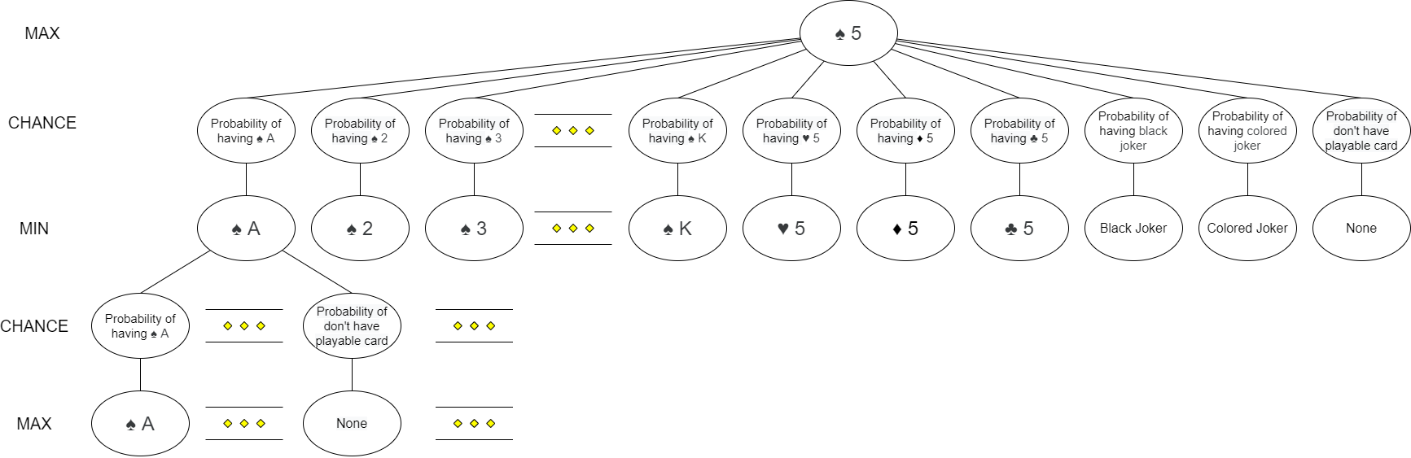
One-card AI (not attack)

Slide 9
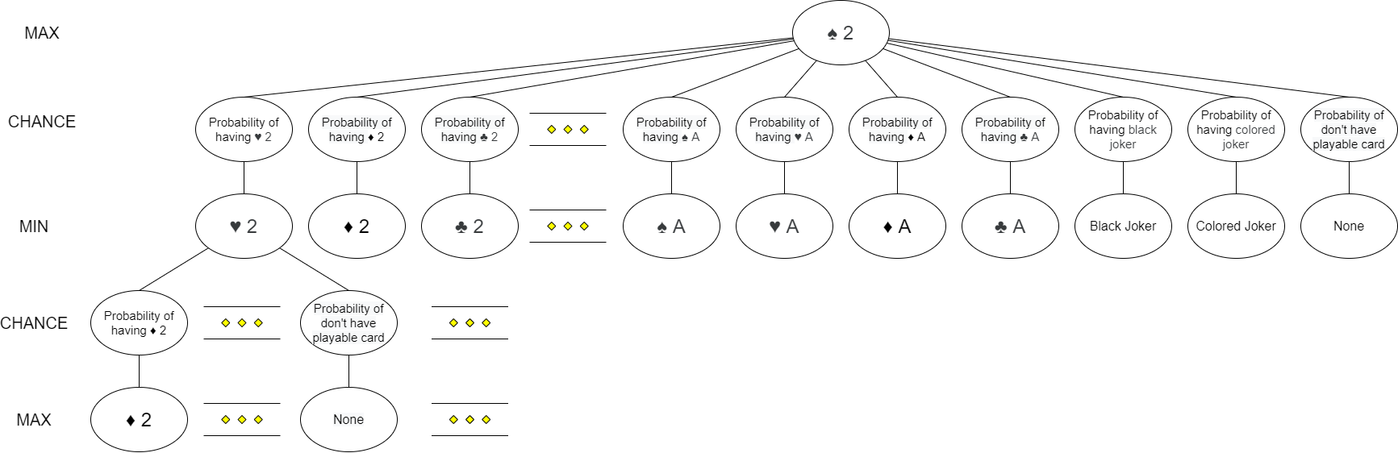
One-card AI (attacked by ‘2’)

Slide 10
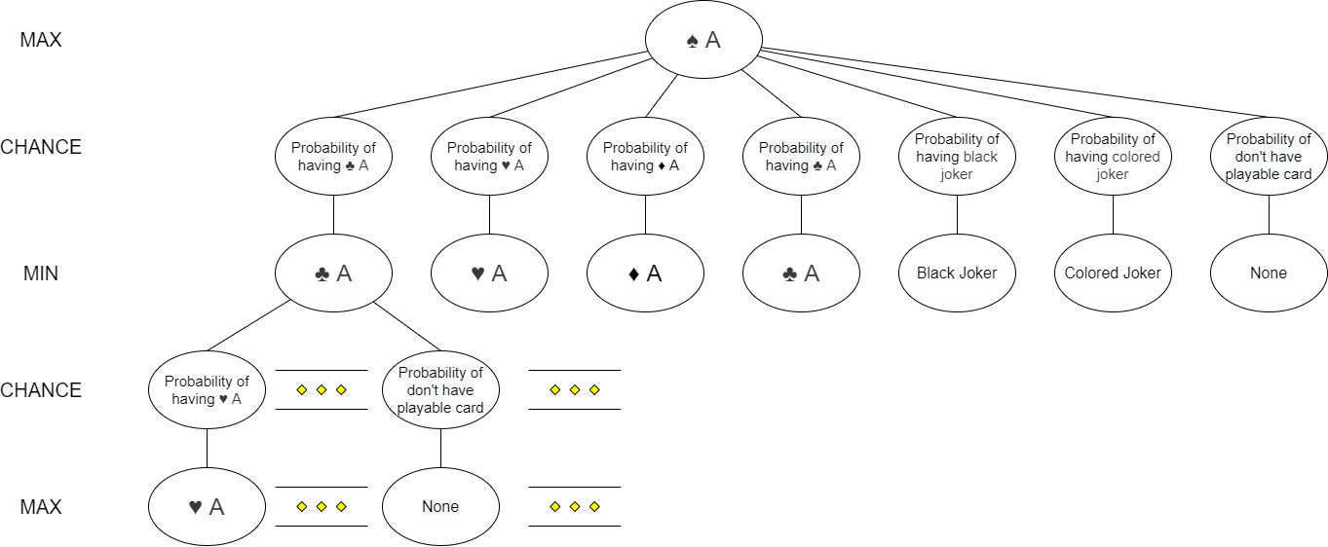
One-card AI (attacked by ‘A’)

Slide 11
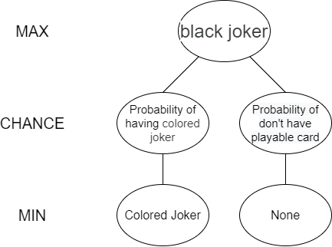
One-card AI (attacked by ‘black joker’)

Slide 12
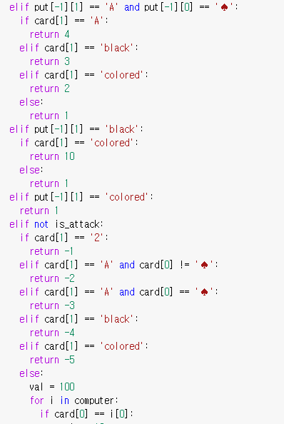
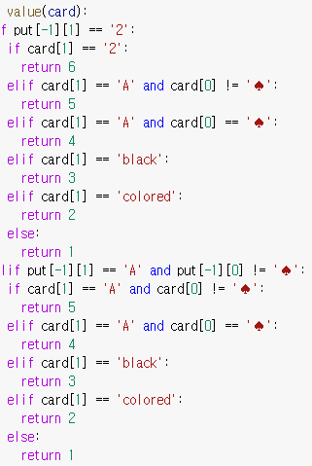
Value function

Slide 13
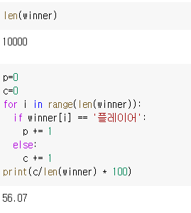
AI win rate

Slide 14
Thank you!

